Slide 1
TRAVEL BEHAVIOUR ANALYSIS
SUPERVISED BY: DR. RAHUL T M
TEAM MEMBERS: -
AMIT KUMAR (2019CEB1002)
BHOLESH MITTAL (2019CEB1006)
NILKANT KAMBLE (2019CEB1013)
PANKAJ DROLIA (2019CEB1019)
RHYTHM PREET SINGH (2019CEB1027)

Slide 2
FUNDAMENTAL UNDERSTANDING OF THE TOPIC
The basic definition of the term “Travel Behavior Analysis” is the elucidation of people’s physical movements outside their reference locations and the numerous physi-socio demographic factors that may affect these travels.
The reference locations are usually the points where the people return to at the end of the day.
The analysis of such behavior of the individuals assists in the development of an advanced transportation infrastructure with a far better transportation experience for the users.

Slide 3
OBJECTIVES OF THE PROJECT
RESEARCH ABOUT THE VARIOUS PHYSIO-SOCIO DEMOGRAPHIC FACTORS THAT AFFECT THE TRAVEL EXPERIENCE OF AN INDIVIDUAL.
DEVELOPMENT OF A QUESTIONNAIRE DERIVED FROM THE RESEARCH.
SHARING OF THE QUESTIONNAIRE WITH PEOPLE FOR DATA COLLECTION.
ANALYSIS OF THE COLLECTED DATA.
PRODUCTION OF A DESIRED CONCLUSION FROM THE ANALYSIS.

Slide 4
RESEARCH COMPONENT
The entailment of a “Research Component” in our project was imperative before its commencement as it familiarizes us with the numerous basic elements and the physio-socio demographic factors that help in the further progress of the project,i.e., development of a Questionnaire.
The basic elements may include:
Purpose of the Travels: -
For instance: Shopping, Work-Related, Schools/Colleges etc.
Duration of the Travel
Participants in the Travel

Slide 5
DEVELOPMENT OF THE QUESTIONNAIRE
On the account of the research conducted, our team has been able to successfully accomplish the task of the development of a ‘Questionnaire’ which is necessary to gather the adequate and suitable information from the respondents.
In addition to some of the factors mentioned in the above slides, we also heed attention to some other factors that might affect the travel behavior of our respondents, such as: -
Occupation Status
Vehicle Ownership
Link to the questionnaire: -
Questionnaire

Slide 6
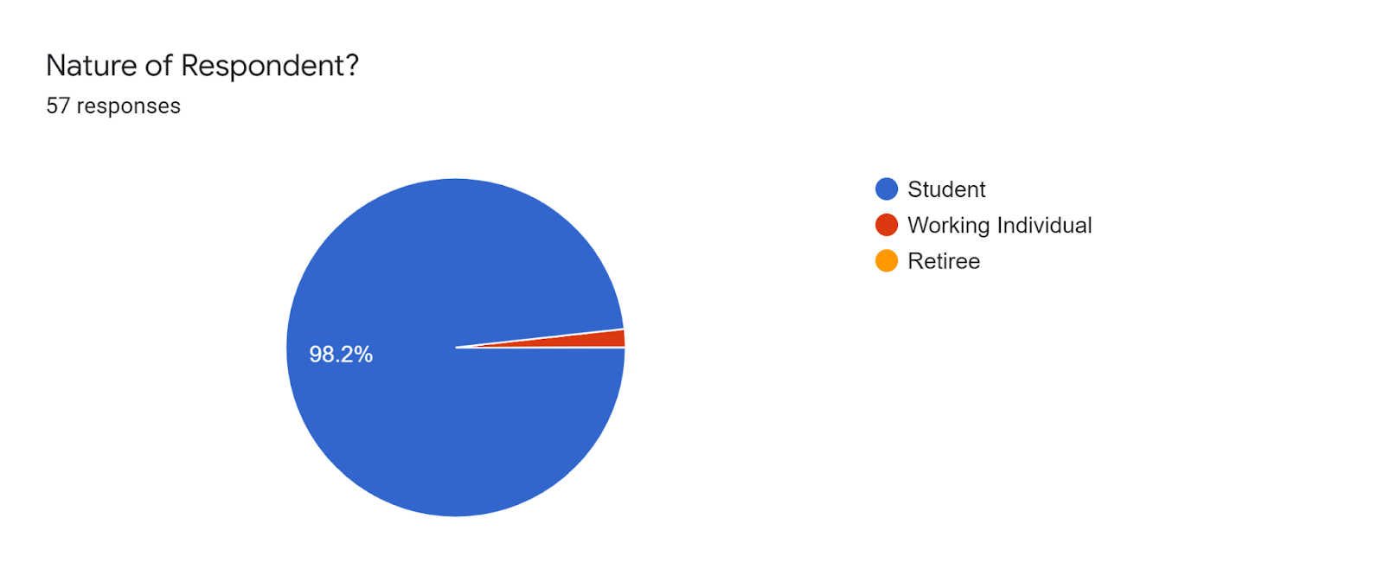
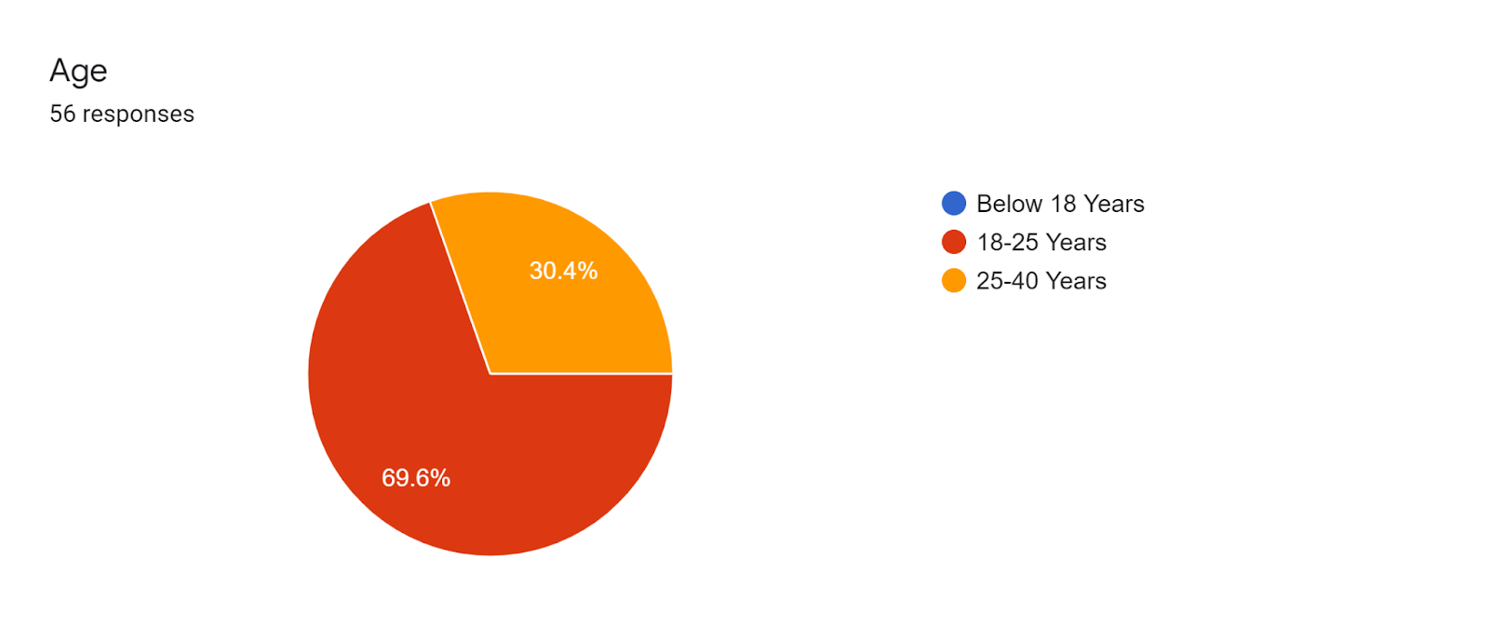
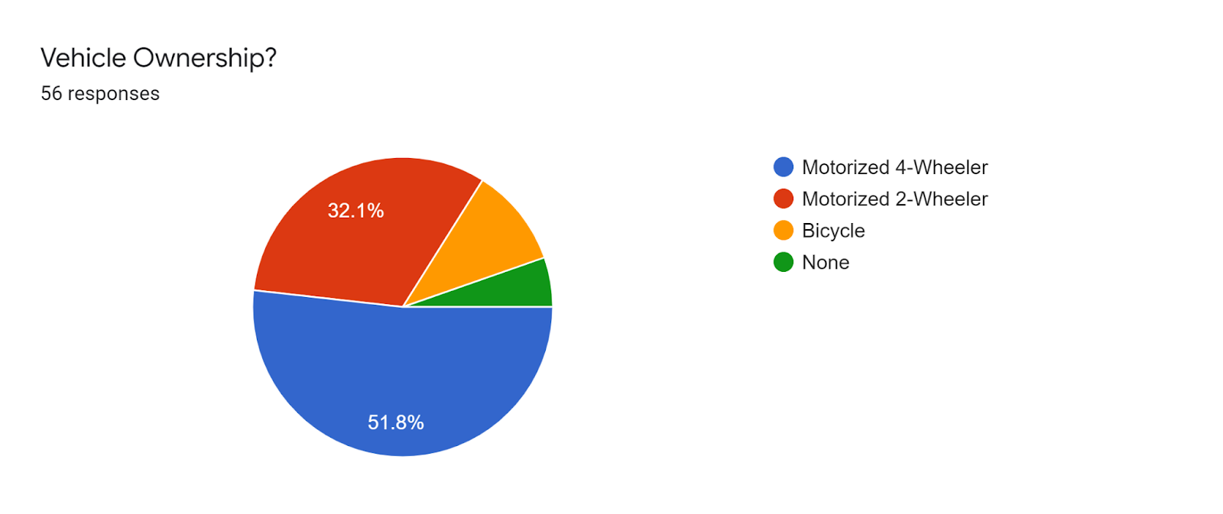
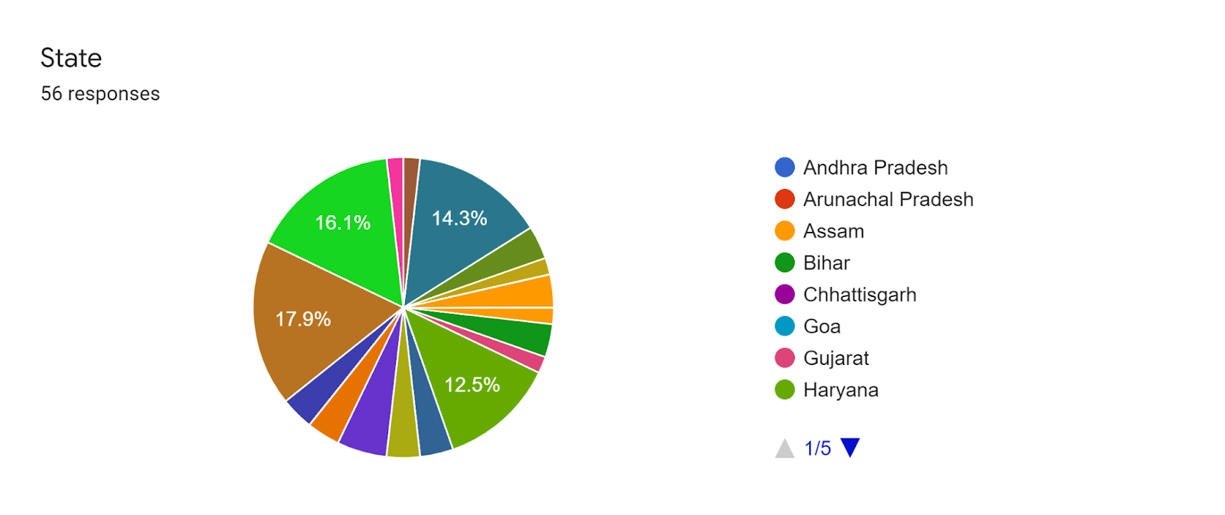
Data Collection
We collected the data by floating a google form which had all the questions related to last trip for shopping and school.

Slide 7
DATA ANALYSIS
We commenced the analysis part of our project after the successful completion of the data collection. The analysis is mainly done with the help of programming language python and analysis software microsoft excel.The analysis process had the various results derived from it are illustrated through various charts are from the next slides.

Slide 8
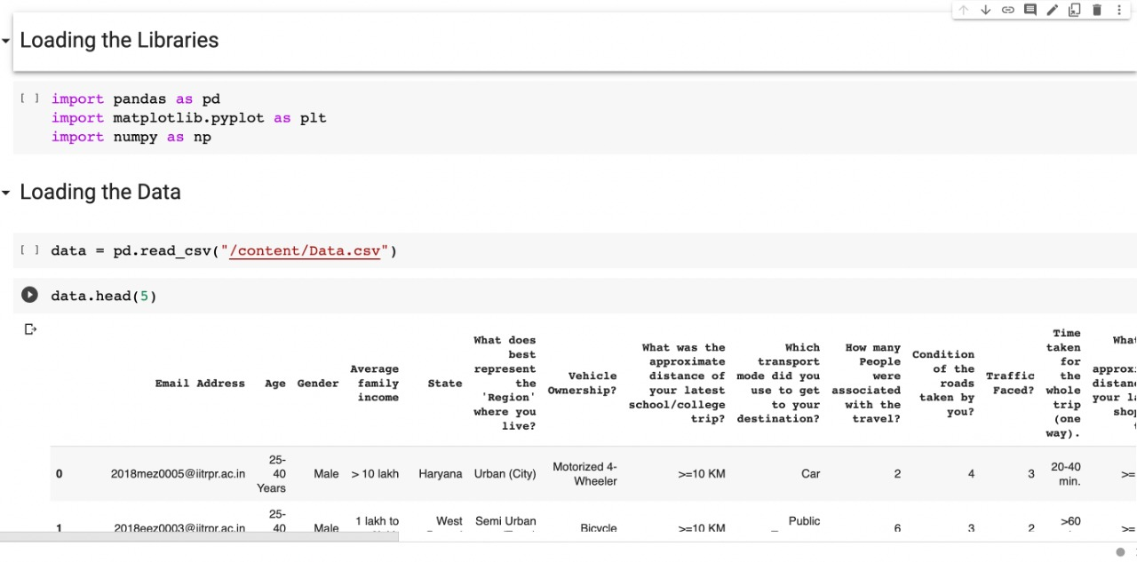

Slide 9
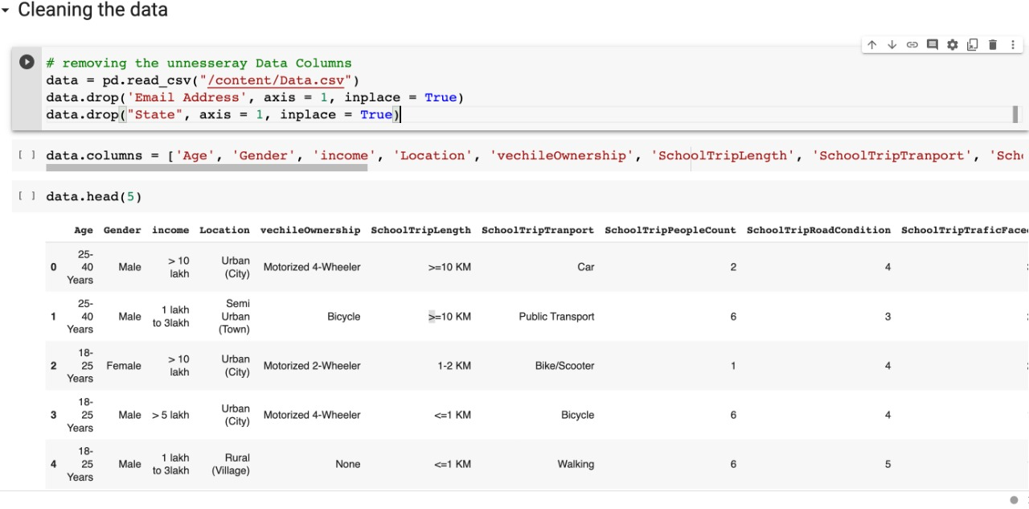

Slide 10
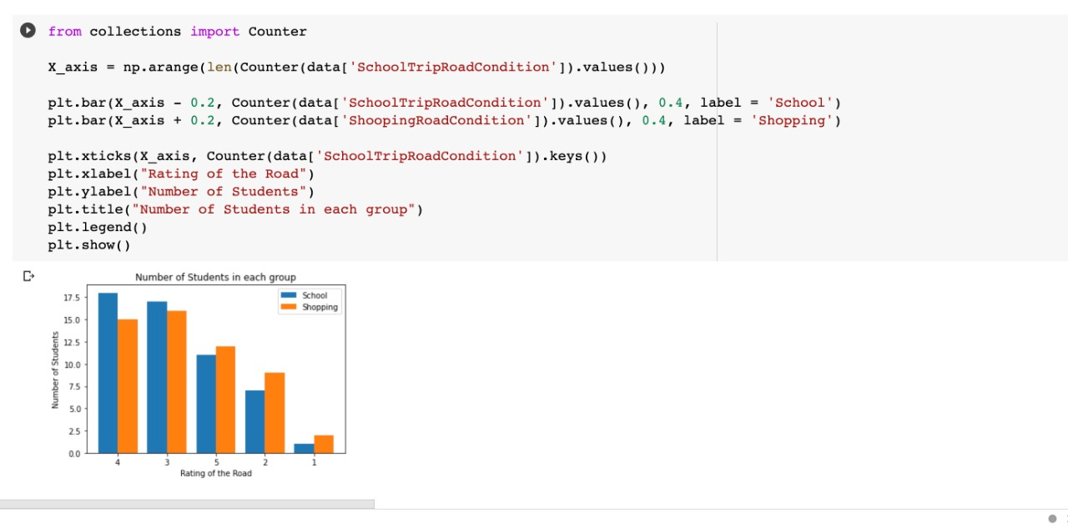

Slide 11
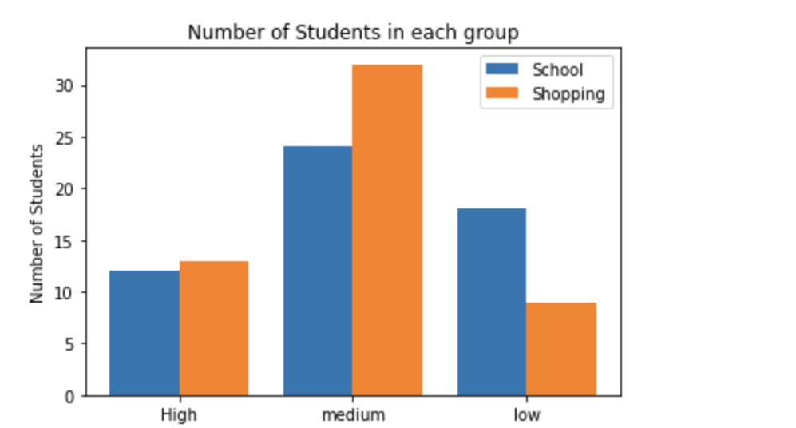
Traffic Faced while going to school/college is slightly less than while going shopping
Avg traffic faced by students while going shopping is 2.09 out of 3 where 3 means very high and 1 means low traffic.
Avg traffic faced by students while going to school/college is 1.88 out of 3 where 3 means very high and 1 means low traffic.

Slide 12
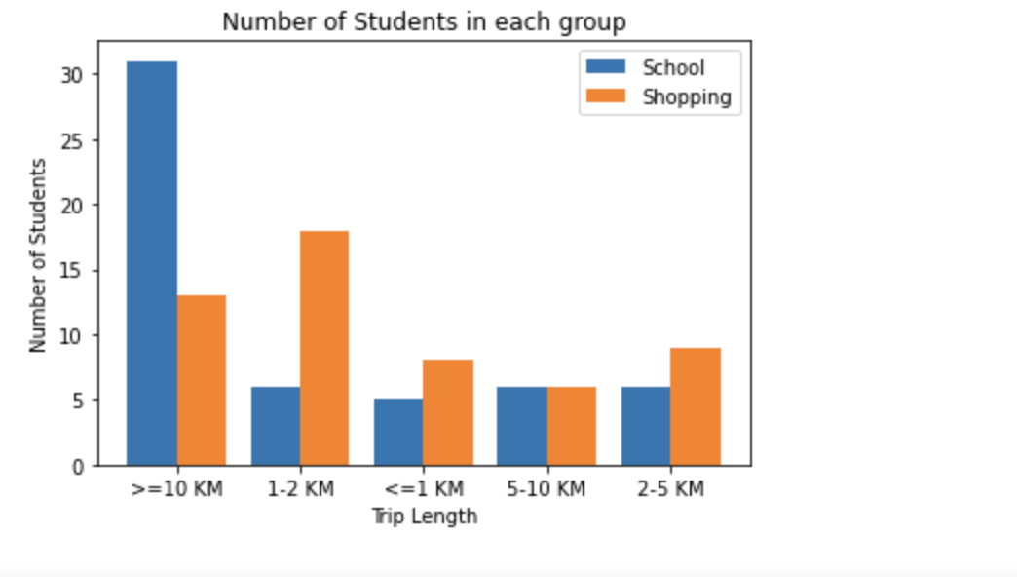
Shops are near to people in comparison to school/college.
Average distance traveled while going to school is 6.75 km
Average distance traveled while going to school is 4.18 km
So, distance traveled while going to school is more than while going shopping so we can conclude that shops are nearer in comparison to educational institute

Slide 13
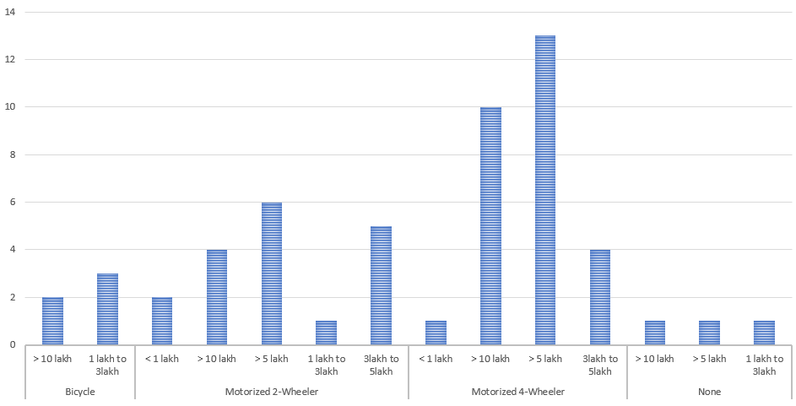
People with income more than 5 LPA or 10 LPA tend to have a motorized 4 wheeler
10 out of 17 (58.8%) people with annual income greater than 10 lpa have a motorized 4 wheeler and 13 out of 20 (65%) people with annual income in range 5-10 lpa have a motorized 4 wheeler. As more than 50% people with average income have 4 wheeler so we can conclude that People with income more than 5 LPA or 10 LPA tend to have a motorized 4 wheeler

Slide 14
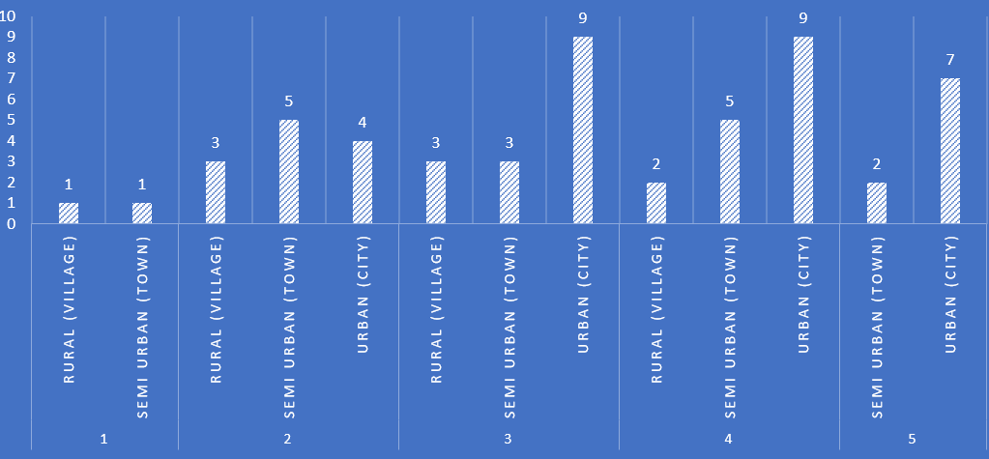
The condition of roads are in better condition in Urban areas than semi urban areas and Rural areas.
Avg. Road condition rating in rural areas 2.67/5
Avg. Road condition rating in semi-urban areas 3.125/5
Avg. Road condition rating in urban areas 3.655/5
Road Rating :- Urban > Semi-Urban > Rural , so we can conclude that urban areas have better road conditions in comparison to semi urban areas and rural areas.

Slide 15
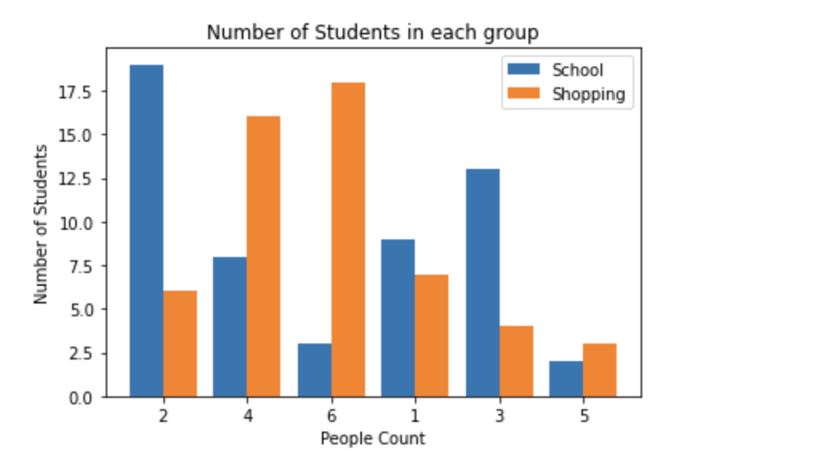
People tend to go in a group of 2 or 3 in school/college while these numbers increases to 4 while going to shopping
Avg no. of people in a group while going to school/college is 2.7(i.e 2 to 3)
Avg no. of people in a group while going to shopping is 4

Slide 16
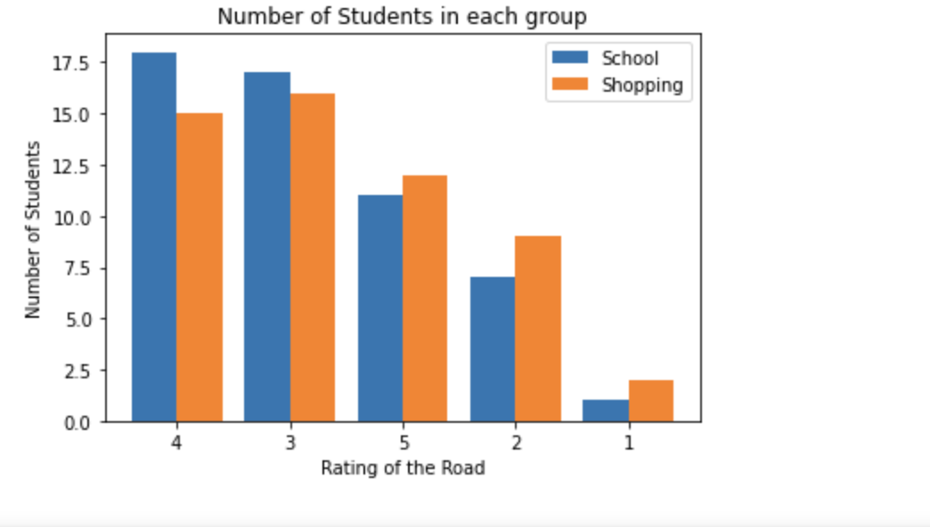
Most of the people have a satisfactory review about the quality of the road that they have taken as the average rating is greater than 3.5 out of 5
Average rating of the road while going for college 3.57 out of 5 where 5 rating is for excellent condition of road
Average rating of the road while going for college 3.5 out of 5

Slide 17
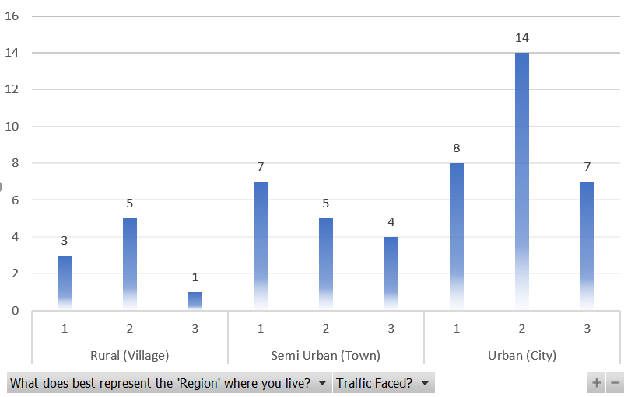
Traffic in rural areas(villages) is less than traffic in Semi Urban areas(towns) and Urban areas(cities)
Avg traffic in Rural areas 1.77
Avg traffic in Semi Urban areas 1.81
Avg traffic in Urban areas 1.97

Slide 18
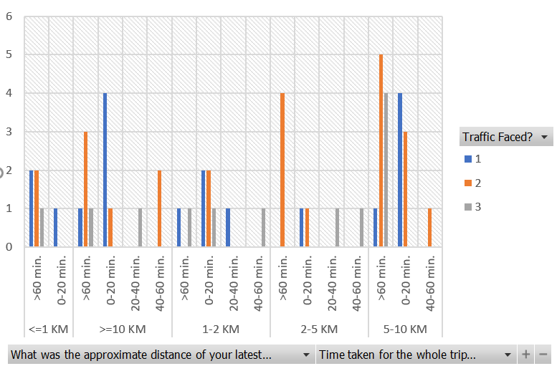
Generally time taken for a trip is inversely proportional to traffic faced.

Slide 19
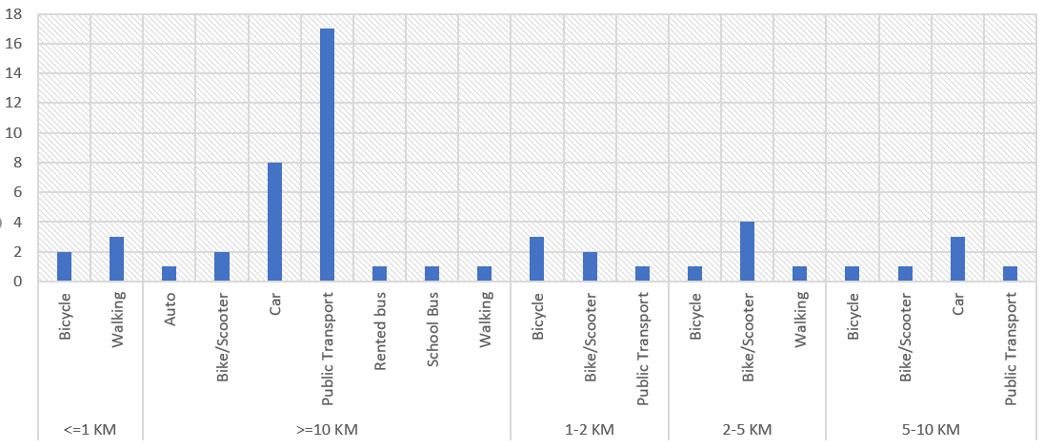
Distance vs Transport : For larger distances people prefer public transport
If people had to go for a distance greater than 10km 54.8% people prefer public transportation while 25.8% chose cars.

Slide 20
Conclusion:-
After creating a questionnaire we collected the data and analyzed it and after analyzing it we come to several conclusions like Traffic Faced while going to school/college is slightly less than while going shopping , Shops are near to people in comparison to school/college , People with income more than 5 LPA or 10 LPA tend to have a motorized 4 wheeler , The condition of roads are in better condition in Urban areas than semi urban areas and Rural areas , People tend to go in a group of 2 or 3 in school/college while these numbers increases to 4 while going to shopping , Most of the people have a satisfactory review about the quality of the road that they have taken as the average rating is greater than 3.5 out of 5 , Traffic in rural areas(villages) is less than traffic in Semi Urban areas(towns) and Urban areas(cities) , Generally time taken for a trip is inversely proportional to traffic faced and For larger distances people prefer public transport.

Slide 21
THANK YOU!

